Slide 1

Cyclistic Bike share
Stephen Banks
Updated: 1/5/2023

Slide 2

Agenda
Converting Casual Riders to Members
Data Used for Analysis
Data Cleaning & Manipulation
Analysis Summary
Key Findings
Recommendations

Slide 3


Introduction
Current Cyclistic Strategy: Building general awareness and appealing to broad consumer segments using flexible pricing plans: single-ride passes, full-day passes, and annual memberships.
Future Growth Strategy: Maximize the number of annual memberships by converting casual riders to members.
Notes:
While the pricing flexibility will still be in place to attract new customers, converting casual riders to members is the key to future growth. Our finance analysts here at Cyclistic have concluded that annual members are much more profitable than casual riders.

Slide 4

Annual Members vs. Casual Riders
How do annual members and casual riders use Cyclistic bikes differently?
Notes:
One of the first steps we need to take to build a solid marketing campaign is to look at how annual members and casual riders utilize the bikes.
My initial hypothesis is that annual riders use the bikes more for travel and therefore have a lower travel duration. Since they are most likely using the bikes for traveling, they will also begin their return route from the end station of their initial route. I also expect that they utilize the bikes more heavily during the weekdays.
For casual riders, I would expect that they would have a more even distribution of bike use because they are riding casually and do not need to be at a certain place by a certain time and may want to try out the different types of bikes. I would also expect that casual riders have a longer trip duration than members.
Now let us begin looking at the data.

Slide 5
Data Sources Used
Divvy Trip Data
https://divvy-tripdata.s3.amazonaws.com/index.html
Used the 2021 monthly data
License: https://divvybikes.com/data-license-agreement
Google Maps
Used to review routes taken by members/casuals
National Weather Service
https://www.weather.gov/wrh/climate

Slide 6

Data Cleaning, Manipulation, & Analysis
Using SQL, Excel, & Tableau

Slide 7
Cleaning, Manipulation, & Analysis Process
Data Table Compilation
Compile all 12 months of CSV data into one data table while excluding rows with null values.
Data Removal
Drop columns of data I won’t need.
Test Field Calculations
Test and add field calculations to row values.
New Calculated Fields
Analysis Querying
Create new columns with calculated values.
Run analysis queries on finalized data table.

Slide 8
Cleaning & Manipulation Review
Negative Ride Lengths
Outliers
Removal of negative ride length entries.
It shouldn’t be possible to have a negative ride duration.
Outliers are significantly impacting the ride length averages.
Some rides last as long as 38 days, which would cost approximately $9,500. This seems like an error since most people wouldn’t spend 38 days riding a bike or $9,500 on the bike ride.
Notes:
After setting up my data table for querying, I noticed that there are some ride lengths that have negative values.
Because outliers are significantly impacting the ride length averages, I will switch to using the median ride lengths as that will provide more accurate numbers for analysis. I will need confirmation that these outliers need to be removed from the dataset since they impact the rider type, bike type, ride duration, and are confirmed by extremely high ride costs.

Slide 9
Analysis
Ride Median Duration
Ride Totals
Seasonality
Median is used because there are significant outliers that impact the average ride duration.
How are casual and members riding differently by month and day?
Is there some seasonality of riding based on member type?
Notes:
After reviewing the cleaned-up data, I noticed that there are significant outliers primarily showing under the docked bike rideable type that only shows for casual riders. Some of the docked bike ride data seems legitimate, so I won’t remove the outliers from the dataset without confirmation, but I will use the median instead of the average since those outliers are significantly impacting the average.
Casual and member riders ride differently, so we’ll compare how they are riding during the week and each month.
This data is based in Chicago, Illinois where it can get cold and windy, so do the different seasons play a part in how the two rider types ride throughout the year?

Slide 10
Analysis cont...
Bike Type Usage
Route Usage
Rides by Hour of the Day
What bikes are being used?
What is the frequency of use by member type?
Do casual and member riders start at, end at, or have similar routes?
Do casual and member riders ride differently at certain times of the day?
Notes:
There are three different types of bikes available; classic bike, docked bike, and electric bike. How are casual and member riders using them, and are there any similarities or differences?
Are there specific routes that our member types use? I’ll use the route data to see if members are traveling more than casual riders and to show how casual riders may be using the bikes differently than member riders.
I believe that casual and member riders use the bikes at different times of the day, so segmenting out the ride starts should be able to show this.

Slide 11
Bike Type Usage
How do members and casual riders use the bikes?
Casual Riders
Use docked bikes
Electric bike use is about the same as members
Member Riders
No docked bike use
Electric bike use is about the same as casual riders
Notes:
Again, members don’t seem to use docked bikes, so this is something we should investigate further.
Electric bike usage is about the same for members and casual riders. This is a potential area where we can show that a membership is more cost effective for the user if they like using the electric bikes.

Slide 12
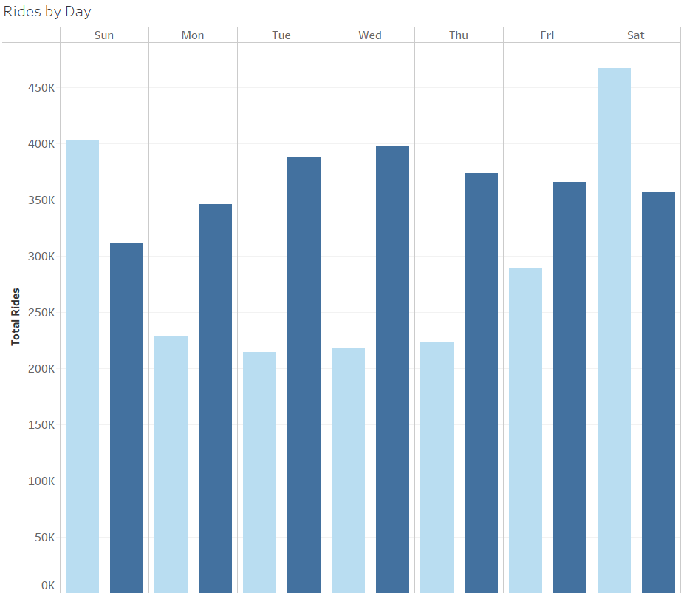

Insight 1: Ride Frequency (Day)
Ride Frequency by Day
Casual Riders
Peak on Saturday/Sunday
Weekend Riders
Ride significantly more than members on weekends
Member Riders
Peak on Tuesday/Wednesday
Consistent riding with low on Sunday
Notes:
From this graph we can see that members and casuals had inverted ride patterns where casual riders peaked on the weekends and members peaked during the middle of the week.
Casual riders are primarily weekend biking warriors with 42.6% of their total rides falling on Sat/Sun. This shows that casual riders are most likely using the bikes for fun and entertainment instead of travel. While the number of rides are much lower than members during the week, there are still a consistent number of rides during the week, so there could be opportunity to convert some weekday riders to members.
Members are much more consistent with their number of rides across the week with their peak riding days being Tue/Wed. They may use the bikes for some fun and entertainment on the weekends or after work, but it is more likely that they use the bikes for travel like commuting to work or school.

Slide 13
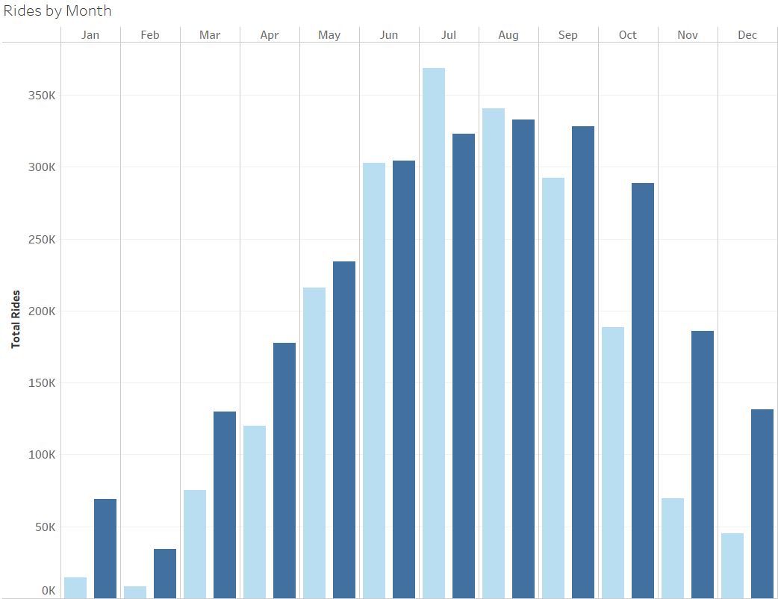
Insight 1: Ride Frequency (Month)
Ride Frequency by Month
Casual Riders
Peak in July/August
Prime riding months June – September
Weather attributed to lower rides in Q1 & Q4
Member Riders
Peak in August/September
Prime riding months June – October
Weather attributed to lower rides in Q1 & Q4
Notes:
Both types of riders peak during the summer months. Members maintained high rides longer into the year.
This graph shows that there is seasonality for both groups. Both groups rode significantly less in Q1 and Q4 most likely due to the temperature and weather conditions. In Q1, the average temperatures was 31.2 degrees Fahrenheit, and Q4 had an average temperature of 46 degrees Fahrenheit with October being the warmest month in Q4 at almost 60 degrees, which is most likely why members still had a high number of rides.
February was the coldest month of the year at 20.2 degrees Fahrenheit and had 13” of snowfall during the month which makes it difficult to ride a bike.
Members accounted for 55.4% of overall rides for the year and casuals accounted for 44.6%.
Chicago average monthly temperatures:
Jan: 29.2, Feb: 20.2 13” of snowfall, Mar: 44.2, Apr: 51.9, May: 60.2, Jun: 74.3, Jul: 74.4, Aug: 77.1, Sep: 70.3, Oct: 59.7, Nov: 40.3, Dec: 38
Jan-Mar: 31.2
Apr-May: 56.1
Jun-Sep: 74
Oct: 59.7
Nov-Dec: 39.2

Slide 14
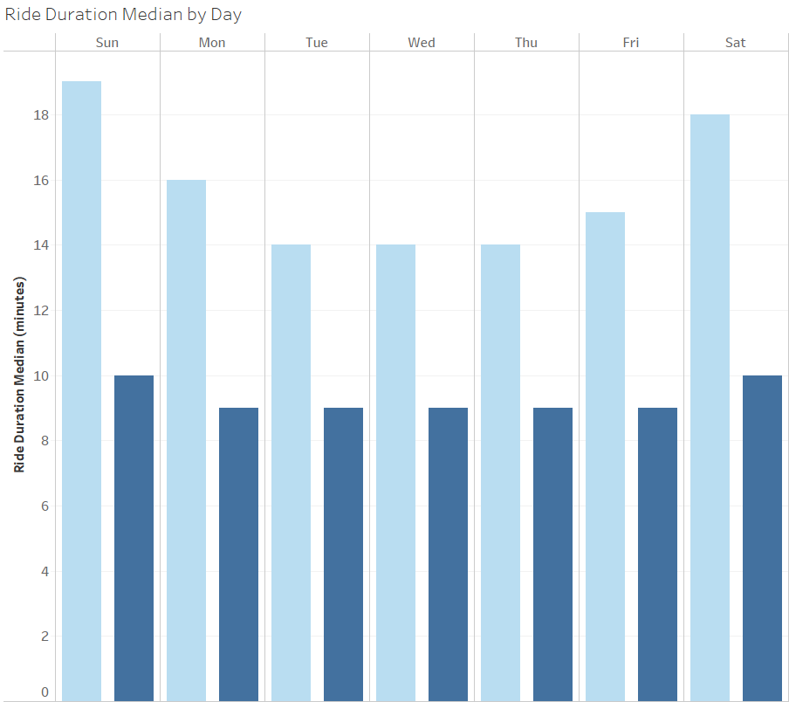

Insight 2: Ride Duration (Day)
Ride Duration Median by Day
Casual Riders
Rode longest on Saturday/Sunday
Rode for 14 minutes or longer
Have longer ride durations that vary by day
Member Riders
Rode longest on Saturday/Sunday
Consistent ride durations between 8-10 minutes
Quick and consistent rides

Slide 15
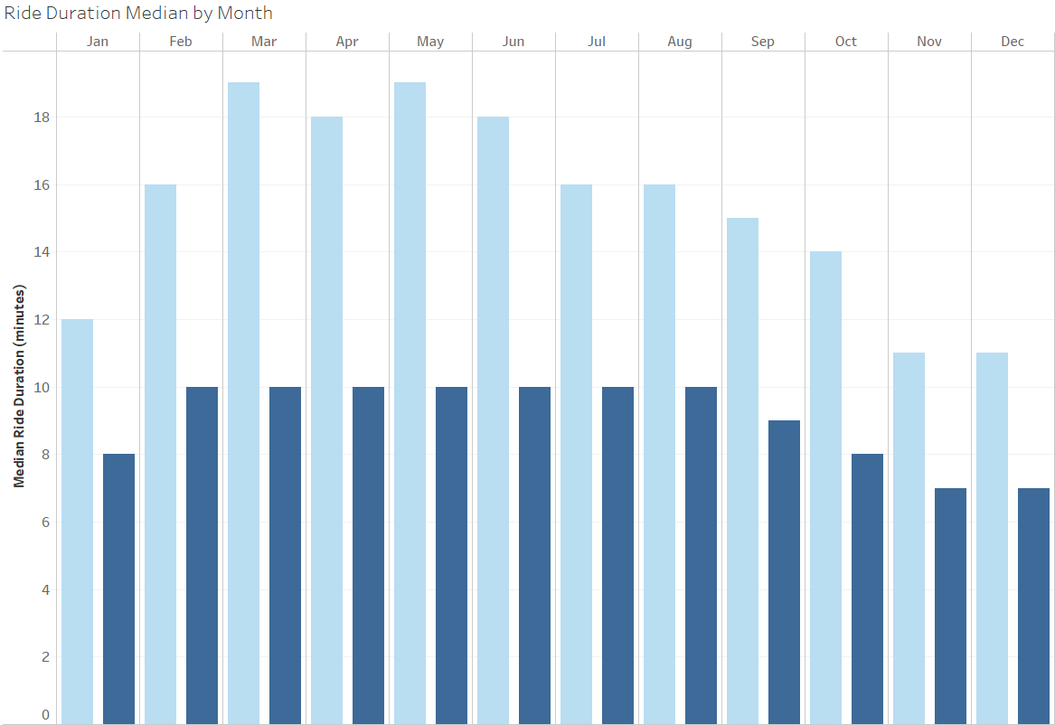
Insight 2: Ride Duration (Month)
Ride Duration Median by Month
Casual Riders
Ride longest between Mar-Jun
Ride lengths are longer the first half of the year and shorten towards the end of the year
Ride durations are 1.5-2x longer than members
Member Riders
Consistent ride duration from Feb-Aug
Jan & Q4 of the year have the lowest ride durations
Notes:
Casuals: Ride durations shorten as the months get colder during the beginning and end of the year.
Members: Same thing for members. Rides durations fluctuated less because of consistent traveling.

Slide 16
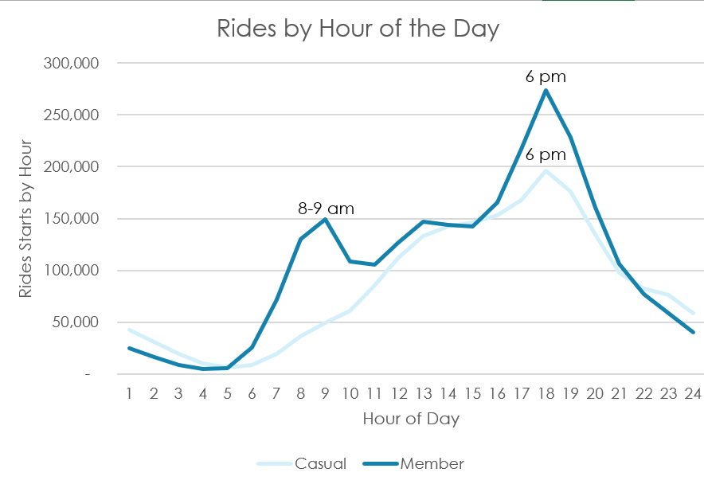
Insight 3: Ride Timing
Rides by Hour of the Day
Casuals Riders
Ride more as the day progresses
Peaks around 6 pm
Member Riders
Peak rides around 8-9 am
Rides continue as the day progresses
Peaks again around 6 pm
Notes:
Casuals: Ride more as the day progresses with no significant peak riding in the first half of the day. Rides peak around 6 pm which would indicate that casual riders are utilizing the bikes after they get off work.
Members: Initial peak riding around 8-9 am which would indicate that the bikes are being used to travel to work or school. Rides then fall for a bit and then progress through the rest of the day. Rides then peak again around 6 pm which would indicate that most members are traveling back home at that time.
Both groups ride frequency tapers off after 6 pm.

Slide 17
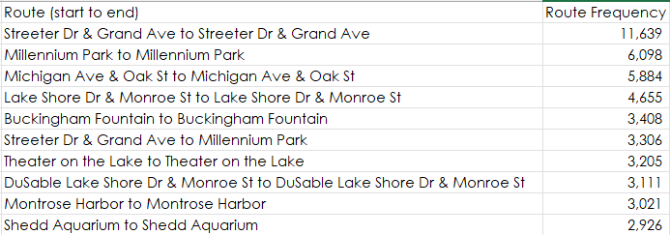
Insight 4: Route Usage
Casual Top 10 Routes
The top 5 routes have the same end station as the start station
9/10 of the top ten routes have the same end station as the start station
Notes:
9 out of 10 of the top ten routes casuals take have the same end station as the start station, which tells me that they are most likely traveling in loops. We know that casual riders most likely use the bikes for entertainment or fun rather than specifically for travel. With that in mind, I looked up the stations on Google Maps and confirmed that at least the top 5 routes are near parks, piers, or bodies of water, which are all good places for fun rides in a loop starting in one place and ending at the starting point.

Slide 18
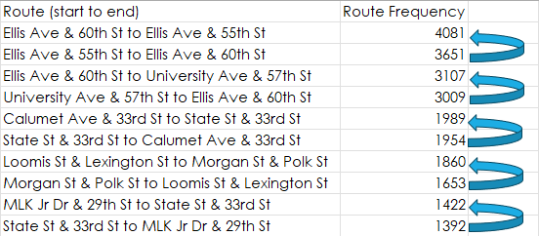
Insight 4: Route Usage
Member Top 10 Routes
Every even route is the return route from the previous odd starting route
This shows that members ride to a place and then from that place back to the starting place
Notes:
The route table here shows that members primarily use the bikes as a means of travel going to one place and then returning from that place to the start point.

Slide 19



Summary
Members and casual riders do ride differently in the following ways:
By the days they ride
The seasonality of months they ride throughout the year
The duration they ride by day and month
How they ride at different times of the day
Their route use

Slide 20
Recommendations
1. Ride Frequency: While casual riders primarily ride on weekends, they still have consistent rides throughout the weekdays. They also use e-bikes as frequently as members, which has a discounted rate for members.
2. Ride Duration: Casual riders ride 1.5-2x longer than members throughout the week and months. Casual riders median e-bike time is 12 min which comes out to about $6, whereas the median ride would cost about $2.
3. Travelers: Based on ride frequency, duration, and timing of rides, there seems to be casual riders who are using the bikes for travel in addition to fun and entertainment. If they are traveling frequently to work or school, then the membership would be a great fit. If those casuals are using the bikes for travel and traveling further distances using the e-bikes, then the membership will be a good incentive with the discounted rates and angel program to acquire e-bike credits.
Notes:
I believe the marketing team should focus on communicating that casual riders will be able to ride more often, longer, and wouldn’t have to think about how much it would cost them per ride if they were to switch to a membership program.
They would get unlimited 45-minute rides using the classic bikes, discounted rates for using the e-bikes at .17/min instead of .42/min and will be able to accrue points toward e-bike credits using the Bike Angels program. We know that casual riders ride longer than members, so being able to ride more often and longer as a member is a huge benefit.
If there are popular events or areas that they like to ride for fun and entertainment, they can use the reserve-ahead feature to ensure they are able to use a bike at their park, pier, lake, etc station loop.

Slide 21


THANK YOU
Stephen Banks

